Slide 1
Integrating the Cell Cycle Ontology with the Mouse Genome Database
David R. Smith
Dr. Mary Dolan
Dr. Judith Blake

Slide 2
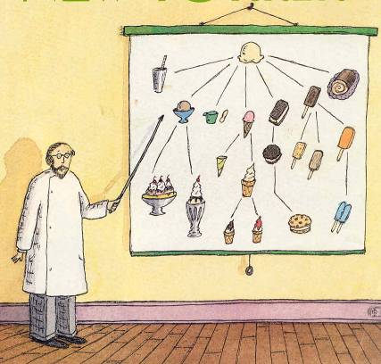
Ontology
A vocabulary of terms used in a specific domain, definitions of those terms, and the defined relationships between them
The two ontologies being used in my project:
Cell Cycle Ontology (CCO)
Gene Ontology (GO)

Slide 3
The Gene Ontology
The Gene Ontology classifies the genes and proteins of many model organisms under three domains:
Biological process
Molecular function
Cellular component
The GO Consortium has annotations from 17 other databases, including MGD
http://amigo.geneontology.org/cgi-bin/amigo/browse.cgi?action=set-tree&open_0=GO:0007049&open_1=GO:0007049&session_id=8702amigo1247669290
http://www.informatics.jax.org/searches/GO.cgi?id=GO:0007049

Slide 4
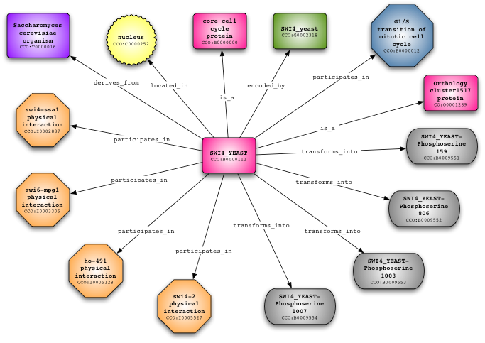
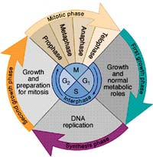
Overview of the Cell Cycle and the Cell Cycle Ontology
The Cell Cycle Ontology extends existing ontologies for cell cycle knowledge and integrates and manages knowledge about the cell cycle components and regulatory aspects. The MGD, however, does not have the data collected in the CCO
There are at least two types of cell cycle control mechanisms. The first ensures clean transitions from phase to phase. The second is checkpoint control. Ensuring that the previous phase is complete
http://www.cellcycleontology.org/
http://www.visembryo.com/images/CellCycle.gif
Notes:
Talk about cancer and the cell cycle.

Slide 5
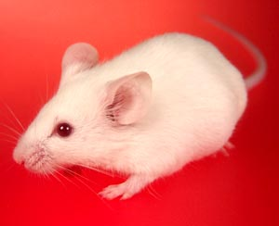
Mouse Genome Database
The Mouse Genome Database is the international database resource for the laboratory mouse. The resources in MGD that are of interest to my project are:
GO annotations
Human-mouse orthology
Phenotypes
Pathways
Disease associations
Expression
http://www.petwebsite.com/mice/mice_images/mouse_5.jpg
Notes:
Want to add Cell Cycle data to these resources.
May not get to Expression.

Slide 6
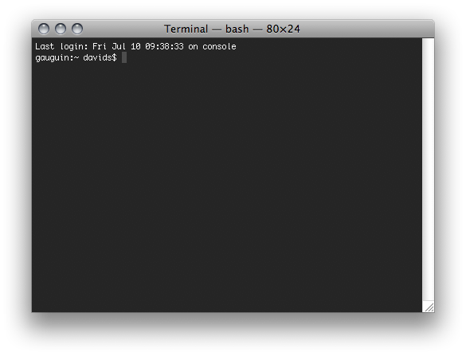
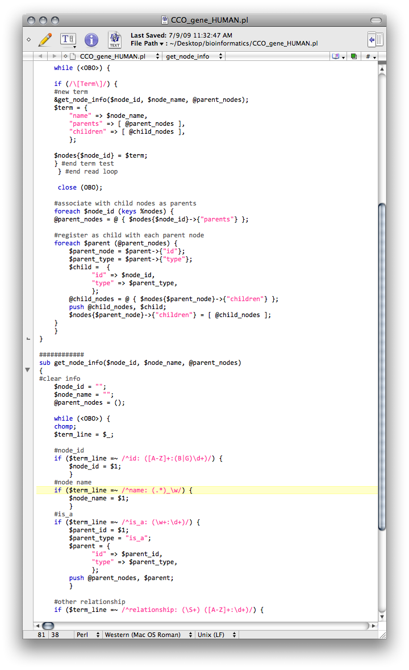
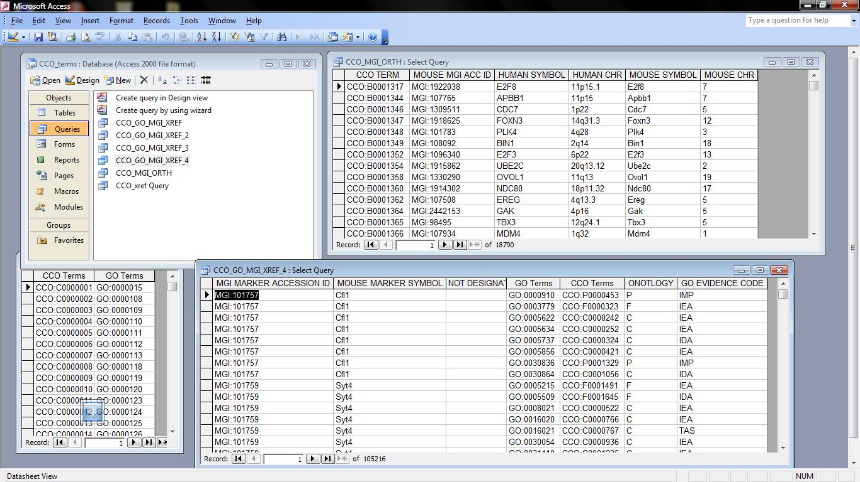
Tools
Perl
Microsoft Access
Notes:
Talk about regular expressions
Talk about joins and SQL

Slide 7
Objectives
Use the Gene Ontology and resources at Mouse Genome Informatics (MGI) and find the relations between the CCO and the Mouse Genome
Explore methods of integrating the data in the CCO with the MGD through cross-references and queries
Develop a completed database with annotated data
Notes:
Talk about different data sources and the problem of matching ids (alt ids, different notations, names)

Slide 8
Progress so far
Using Perl, I’ve created tables of cross-references between the CCO and the GO
Using Microsoft Access, I’ve used these tables to create joins and run queries that output tables that show the relationships between the CCO and the MGD through the GO and Orthologs of the mouse genome.

Slide 9
What’s next
OBO-Edit: Explore the temporal relations in the CCO and how to integrate them into the MGD
Protégé: Create an OBO or OWL file of the data from the separate databases and create one database to add to the mouse genome database or to the GO

Slide 10
Thanks
Dr. Judith Blake and her lab
Dr. Mary Dolan
Iry Witham
Dr. Jon Geiger and the Jackson Lab Student Summer Program
National Human Genome Research Institute
The Horace W. Goldsmith Foundation

Slide 11
Bibliography
Too lazy to do this right now

Slide 12
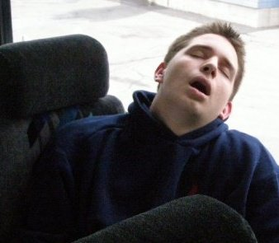
Questions?

